Slide 1
SE361- Sprint #0 Review
Anna Vadella, Elijah Heslop, Garret Blake, Kwesi Kyei-fordjour, Daniel Field

Slide 2
Table of Contents
01
Team Basics
Team Name, Team Roles, Selected Project, Project Tracking, Software setup
02
Scrum User Stories
Scrum User Stories Developed from Requirements of Selected Project
03
Rough GUI Frontend Design
Rough (emphasize on rough) outline of GUI Frontend designed via PowerPoint

Slide 3
Team Basics
Team Name: Red Agents
Selected Project: IT Help Desk
Team Roles:
Scrum Master - Anna
GUI Frontend - Garret and Daniel
Database Backend - Elijah and Kwesi

Slide 4
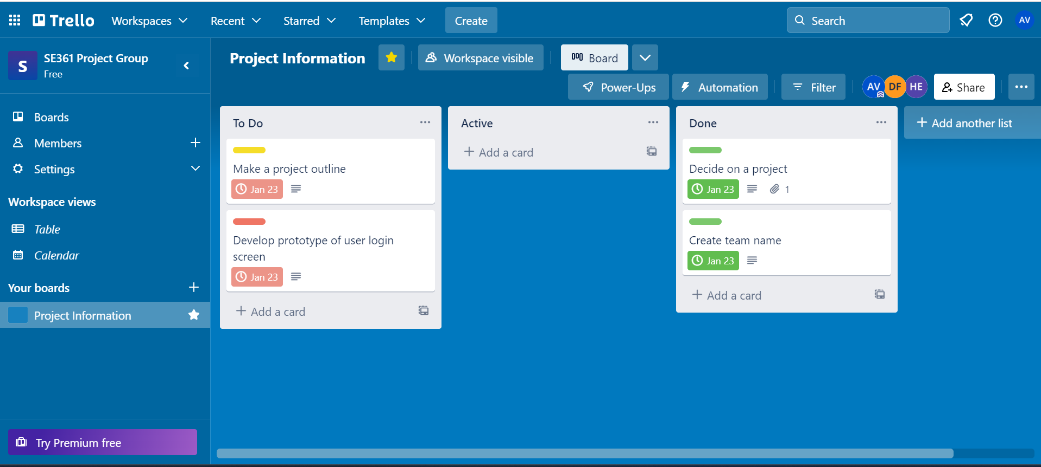
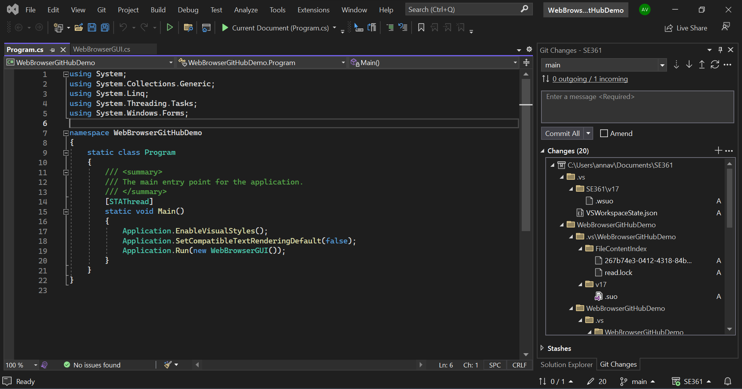
Team Basics
Trello for Project Tracking
Current Software Setup
Error Message to be Handled (Challenge)

Slide 5
Scrum User Stories
Admin
Report Manager
I want to be able to register users.
I want to be able to generate reports for users.
I want to be able to manage E-mail reports.
I want to be able to manage and assign tickets to members of the Support Team.
Project Member
IT Support Team
I want to be able to login to the program.
I want to be able to view the problem list and solve problem tickets.
I want to be able to raise and reopen tickets.
I want to be able to change the status of tickets.
I want to be able to invite other team members to a ticket.

Slide 6
Rough GUI Frontend Design
IT DESK LOG-IN
Username:
Password:
Forgot Password?
Don't have an account?

